Slide 1
The Industrial Revolution, cont’d
S. Anderson
World History

Slide 2
The Industrial Revolution, cont’d
The Industrial Revolution brought about fundamental changes in the way goods are made. It introduced mass production (the large-scale production of identical goods) and the use of new sources of energy to meet human needs. People started making goods in factories instead of at home, and they began to use steam power to run machinery. Science also became more closely linked to technology, resulting in a stream of constant innovations.

Slide 3
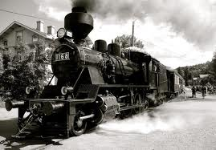
Causes of the Industrial Revolution
The Industrial Revolution first began in Great Britain in the 1700s. There were several important factors that made Great Britain ready for the Industrial Revolution:

Slide 4
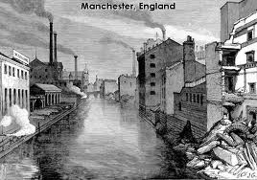
Pre-Conditions for Industrialization
Geographical Advantages
Great Britain had many harbors and
rivers, and plentiful coal. As an island,
it was protected from invasion, close
to European markets, and well-located
for trade with other areas.
Transportation and Communications
Great Britain had a well-developed coastal trade, canals, port towns, an excellent postal service, daily newspapers, and the most powerful navy in the world.

Slide 5
Pre-Conditions for Industrialization, cont’d
Large Colonial Empire
Britain’s far-flung colonial empire brought valuable raw materials to her ports. Running a colonial empire contributed to the development of sophisticated financial and commercial skills.
Powerful Middle Class
A large and powerful middle class participated in government and promoted free enterprise and economic improvement. They brought together capital, labor, and new industrial inventions.
Agricultural Improvements
British farmers used scientific methods to boost productivity, such as enclosing common lands, rotating crops, and careful animal breeding. Fewer people were needed to work on farms.

Slide 6
Causes of the Industrial Revolution, cont’d
With its favorable geography, colonial empire, political stability, global trade, prosperous agriculture, and thriving middle class, Britain was ready for something dramatic to happen in its economy. Advances in science also helped set the stage. Inventors and business owners took a “scientific approach” to solving problems. Because of scientific advances, British manufacturers had technical skills to build new machines.

Slide 7
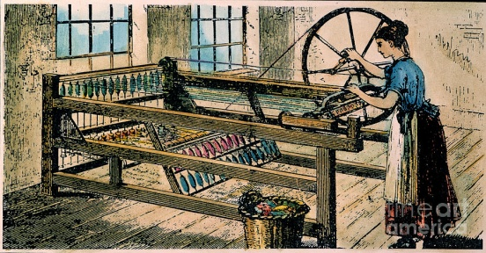
Innovations in Textile Manufacturing
A series of British inventions then triggered the Industrial Revolution. Advances in science helped inventors take a practical approach to problems. The revolution began in textiles and spread to other fields. For centuries, cotton and wool were pulled and twisted on a spinning wheel to make thread or yarn. The spinning jenny (1764) used a single wheel to control several spindles at a time. This replaced the single spindle on conventional spinning wheels. This allowed many threads to be spun at once. Larger quantities of threads could soon be made quickly and inexpensively.

Slide 8
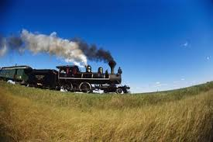
Innovations in Textile Manufacturing, cont’d
Other similar inventions improved both spinning and weaving. James Watt, a Scottish inventor, improved the steam engine (1769) by creating separate chambers for the steam to get hot and to cool down. Watt’s improved steam engine made steam power available for mechanical purposes. His improvements allowed factory construction to be placed anywhere, since factories were no longer dependent on water to power their machines.

Slide 9
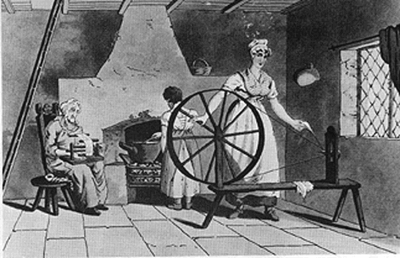
The Shift from Home to Factory
Before the Industrial Revolution, craftsmen worked at home, spinning wool, cotton, and linen by hand, and then weaving the thread or yarn into finished cloth. Merchants often dropped off raw materials and collected the cloth. This was known as the domestic system.

Slide 10
The Shift from Home to Factory, cont’d
During the Industrial Revolution, large numbers of workers began working together in factories. In factories, workers could be supervised and could use machines driven by water and steam power. The rate of production in the new factories was astonishing. By the standards of the time. As a result of these improvements, the price of cloth decreased and the demand for textiles rose. Raw cotton was imported in England, largely from the Southern United States. In England, it was spun into thread and woven into cotton cloth in factories. From there, the cloth was shipped all around the world.

Slide 11
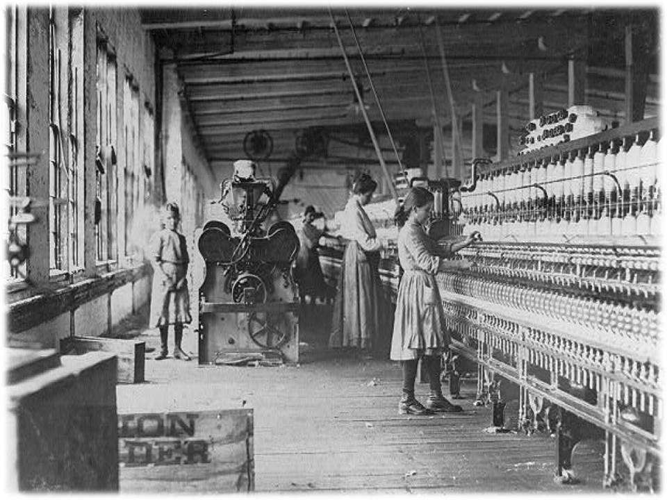
The Shift from Home to Factory, cont’d
England’s plentiful supplies of coal and water provided the resources needed for steam power to run the factories. Its engineers and craftsmen were skilled at making machinery. As the demand grew for less costly British textiles, more and more factories were built, employing greater numbers of workers.

Slide 12
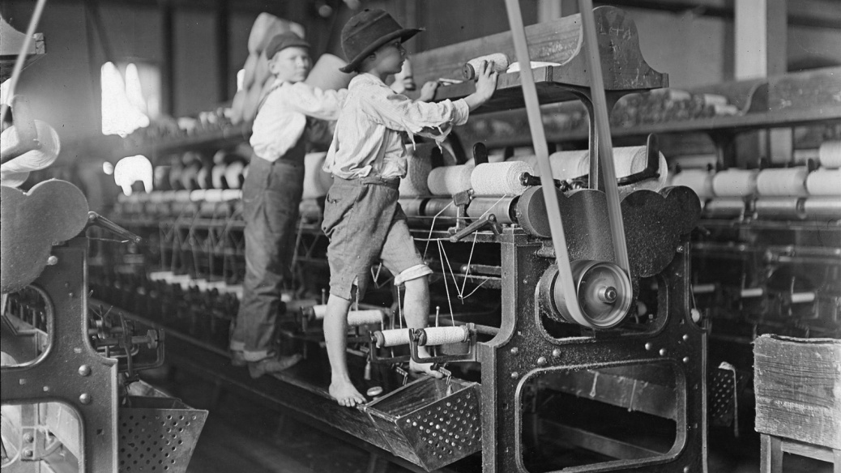
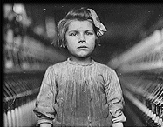
Working Conditions
While factory owners grew richer and more powerful, the conditions of the new “working class” worsened. Early factories were often appalling places to work, with unsafe and unpleasant conditions. Work hours were long, and workers received barely enough pay to live on. Women and children also worked. Children were used to crawl in and clear the machines, a dangerous task. In hard times, factory workers lost their jobs and were left to beg steal, get local poor relief, or die of starvation.

Slide 13
Working Conditions, cont’d

Slide 14
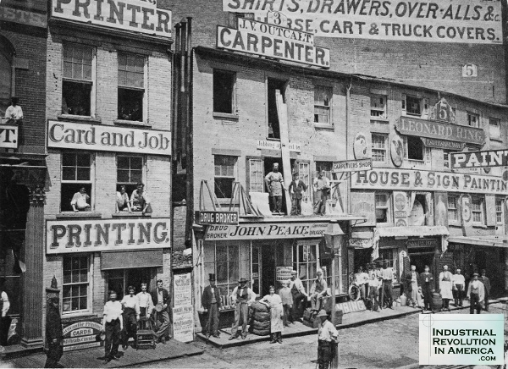
Urbanization
Fewer workers were needed on farms because of improvements in agriculture. With the shift of work to factories, large numbers of workers moved from their farms and homes in the countryside to cities. The migration from rural communities to cities marked one of the largest population shifts in history. Cities became crowded and highly unsanitary. Factory smoke greatly polluted the air. Local governments were often unable to cope with the needs of large numbers of workers.

Slide 15
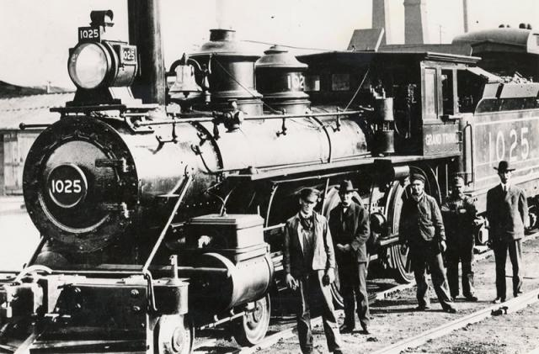
Changes in Transportation Technology
Improvements in transportation accelerated advances in industrialization. Steam engines were applied to steam boats in the early 1800s. They were also used to power locomotives, creating the first railroads in the 1820s. Railroads unified the economy of a region by linking cities, factories, towns, and the countryside together. At the same time, railroad construction required vast amounts of coal, iron, and steel, greatly stimulating the growth of heavy industry.

Slide 16
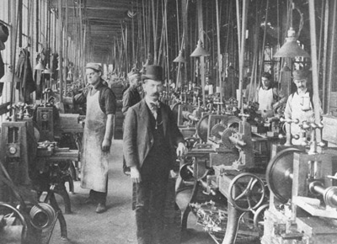
Changes in European Society
The Industrial Revolution led to important changes in society. A new middle class of capitalists, composed of merchants, landowners, and bankers emerged. These people helped to develop the free enterprise system (also known as capitalism).

Slide 17
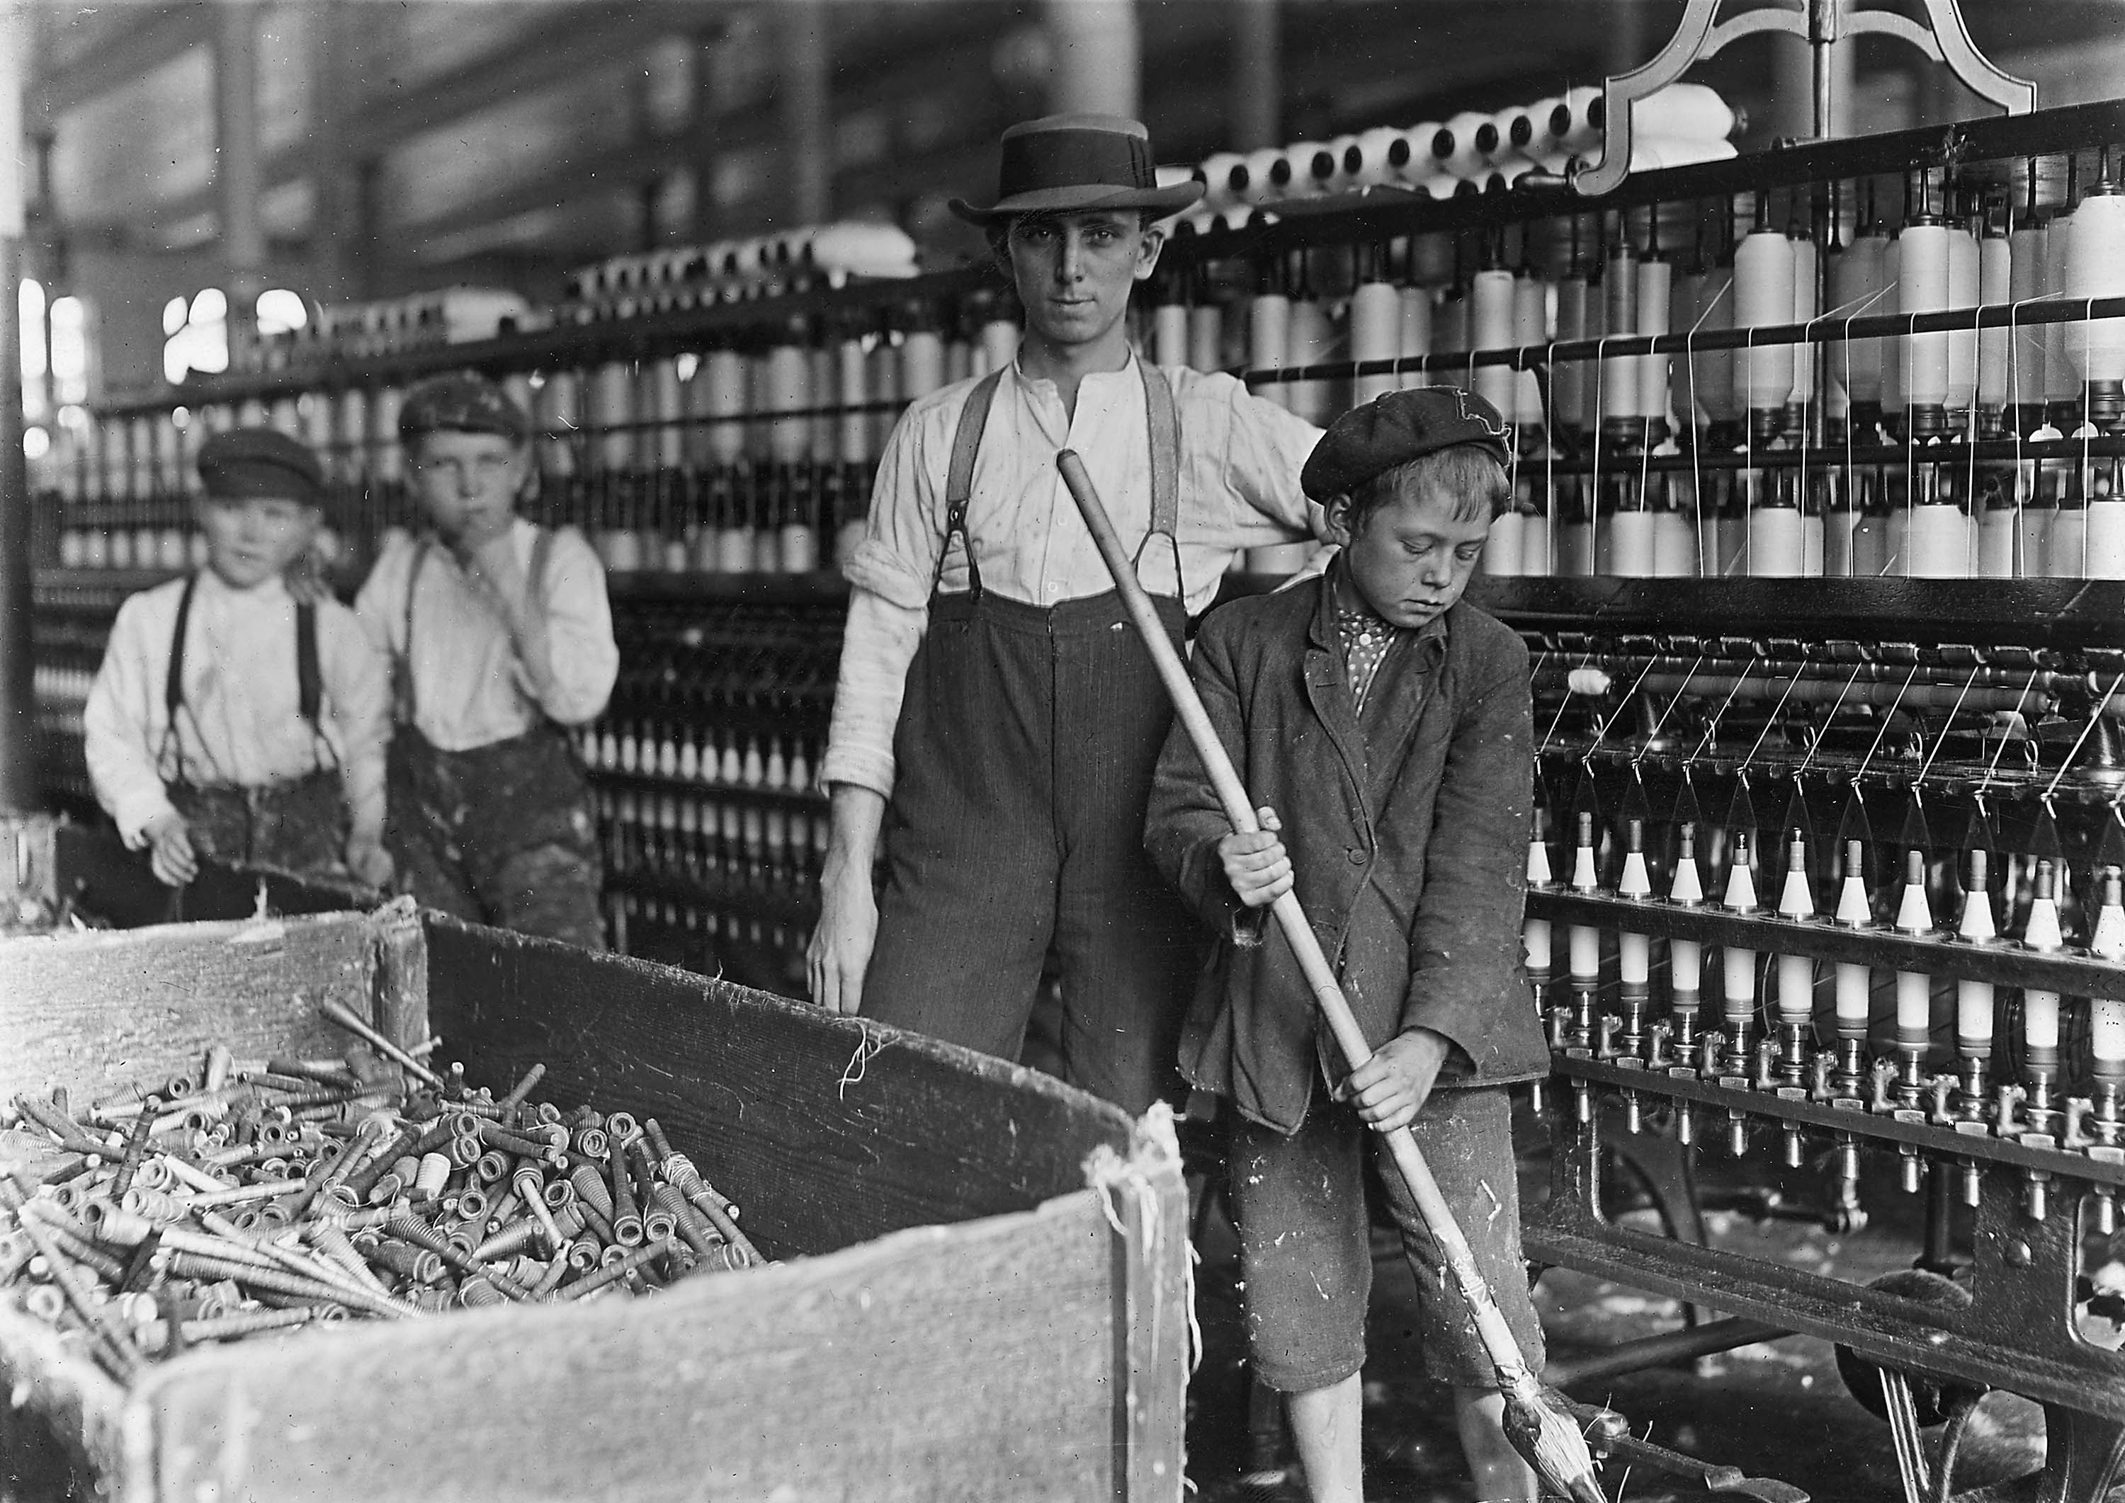
Characteristics of 19th-Century Capitalism
Role of the Entrepreneur.
The means of production (factories) were owned by people known as entrepreneurs. Entrepreneurs organize, manage, and assume responsibility for a business in hopes of making a profit.

Slide 18
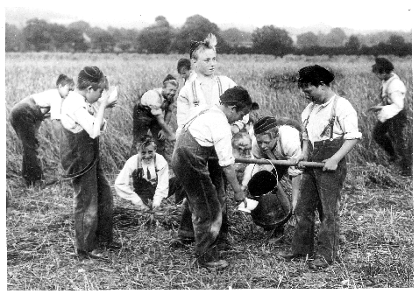
Characteristics of 19th-Century Capitalism, cont’d
Role of the Worker.
Former farm workers left their homes in the countryside for jobs in more populated and industrialized areas. These workers provided their labor, for which they received wages.

Slide 19
Characteristics of 19th-Century Capitalism, cont’d
Role of the Government.
Nineteenth-century governments followed a policy of laissez-faire. This meant that the government did not interfere in relations between workers and business owners.

Slide 20
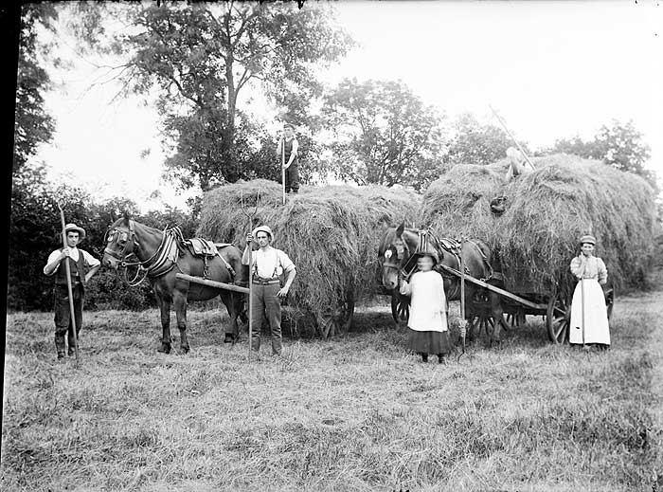
Family in the Industrial Revolution
The Industrial Revolution brought many changes to family life. In pre-industrial times, most people lived in villages. They were peasant farmers or craftsmen. Husbands and wives worked together in the fields or at home., spinning thread and weaving cloth. Children learned from their parents and worked along side them. Few went to school.

Slide 21
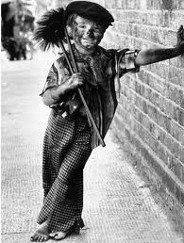
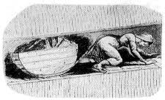
Family in the Industrial Revolution, cont’d.
With the rise of industry, all this changed. Many men, women, and even children began working in factories. Some children were sent to work in factories or mines to crawl in small spaces, until new laws limited child labor. The factory whistle told them when to come to work and when to go. Less time was spent by family members at home or together. Often younger unmarried men and women served as unskilled factory workers.

Slide 22
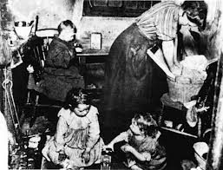
Family in the Industrial Revolution, cont’d.
People moved from villages into towns and cities. Conditions became more crowded and whole families huddled into small apartments, sharing rooms. Many families had less access to fresh water, sunlight, and fresh air. Diseases like cholera and typhus could spread quickly.

Slide 23
Family in the Industrial Revolution, cont’d.
While capitalist classes enjoyed fabulous wealth, historians still debate whether the living standards of workers improved or actually worsened in the early decades of the Industrial Revolution. Later in the century, municipal reforms led to improvements in public water supplies and sewage, although they did not eliminate crowded living conditions. Reformers also introduced free public education for children.

Slide 24
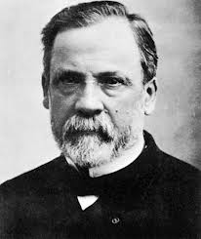
Family in the Industrial Revolution, cont’d.
Scientists like Louis Pasteur also played an important role in improving living conditions for people of all social classes. Pasteur believed most diseases were caused by germs – tiny creatures that could only be seen under a microscope. Many doctors at first resisted Pasteur’s “germ theory” of science. However, Pasteur was able to show how better sanitary practices, like washing hands and boiling instruments before operations or delivering babies, could reduce infections and deaths. Pasteur also developed new vaccines to combat diseases like anthrax and rabies, which he also thought were caused by germs. He pioneered the heating of liquids to kill germs.

Slide 25
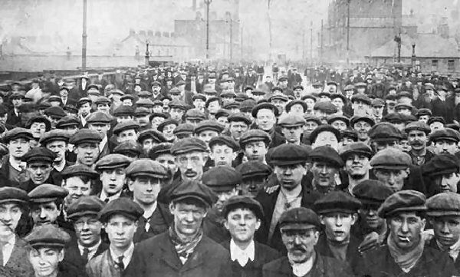
Reform Movements
The changes caused by the Industrial Revolution brought about both social and political reforms, first in Great Britain and then in the rest of Europe.

Slide 26
Reform Movements, cont’d.
Social Reforms.
The misery of the working classes and the injustices of capitalism began to disturb the conscience of the new middle class. They also feared working class violence. This led Parliament to ban women and children from working in the mines, to limit working hours to ten hours, and to bring about safer working conditions. Poor law reform established work houses for the unemployed.

Slide 27
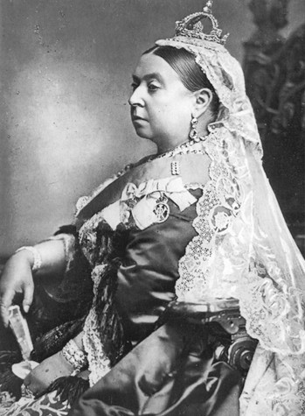
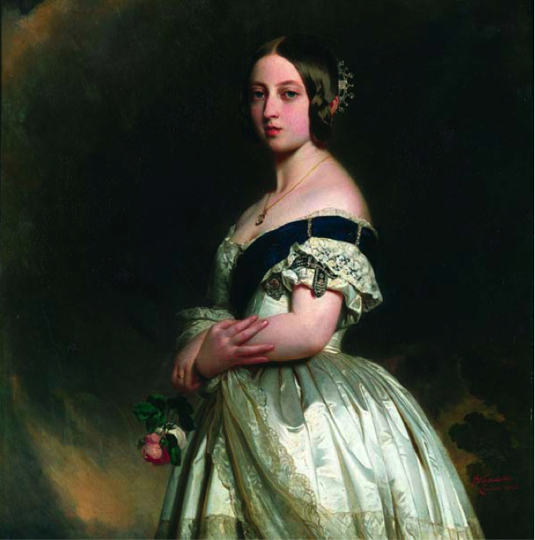
Reform Movements, cont’d.
Queen Victoria was a popular monarch. Victoria favored social reforms to help her subjects. With her husband, Prince Albert, she also favored many private efforts to help the poor.

Slide 28
Reform Movements, cont’d.
Municipal Reforms.
Municipal reform made cities cleaner and more healthful places to live. Public health officials improved the quality of drinking water and introduced sewer systems to make cities safer and prevent the spread of diseases like cholera. Street lamps and police forces made cities safer. Governments also introduced the first free public elementary schools to prepare citizens for adulthood.

Slide 29
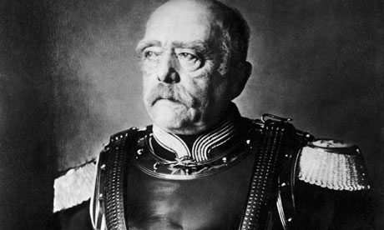
Reform Movements, cont’d.
Workers Unions.
Some workers organized into unions and threatened to strike if they did not obtain higher wages and better conditions. Even those favoring conservative values like Otto von Bismarck in Germany, introduced social reforms, such as social security insurance, in order to win the favor of the working class.

Slide 30
Reform Movements, cont’d.
Political Reforms.
The rising middle class of factory owners, merchants, and bankers demanded greater political power. In Great Britain, the old House of Commons represented the counties and many old towns, known as boroughs. Many new towns had no representation at all. The Reform Bill of 1832 gave greater representation in Parliament to the new towns and extended voting rights to the middle class. Liberals argued these gradual reforms would avoid a revolution. Later reform bills gradually extended voting rights to the working classes. By the late 19th century, all adult males could vote in Britain, but not women.

Slide 31
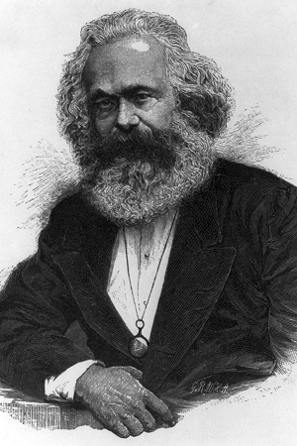
Marx and the Birth of Communism
Two critics of the new capitalist system were Karl Marx (1818-1883) and Friedrich Engels. Their ideas were published in The Communist Manifesto (1848). Marx later wrote Capital (1867). Marx’s ideas became the basis of Communism. Marx believed that workers created value through their labor. He believed that business owners used their power to take advantage of workers by taking for themselves most of the value of what workers produced.

Slide 32
Marx and the Birth of Communism, cont’d
The capitalist, Marx said, only paid workers the minimum they needed to survive. The rest that they produced, known as the “surplus value,” was kept by the owner for himself. Over time, owners would get richer and richer, while their workers, known as the proletariat, would get poorer. Marx predicted that the conditions of workers would become so bad that they would eventually rise up and overthrow their capitalist rulers in a violent revolution.

Slide 33
Marx and the Birth of Communism, cont’d
After the revolutions, Marx predicted that workers would establish an equal society and live in perfect harmony. Marx called this system “Communism.” In pure Communism, everything would be owned in common. There would be no private property. There would also be no classes in a Communist system. Cooperation would replace competition, allowing everyone’s needs to be met. During his lifetime, Marx believed that a Communist revolution would soon occur in an industrialized country in Western Europe.

Slide 34
Socialism
Other critics of the new industrial conditions did not go as far as Marx and Engels. They did not call for a violent revolution. These critics were called socialists. However, they did think it was necessary to improve conditions for workers.

Slide 35
Socialism, cont’d
Socialism first began in the 1800s as a political movement in response to the injustices of industry and the exploitation of workers. Many workers had to work long hours for low wages in unsafe conditions. Socialist reformers preached more state influence, equal rights, and an end to the inhumane treatment of workers. These reformer believed the best way to safeguard workers would be to pass laws to protect workers and even to have the government own some businesses for the workers’ benefit. They formed their own socialist political parties across Europe.

Slide 36
Socialism, cont’d
Socialists disagreed with the Communist belief that workers’ conditions could only be improved through violent revolution. Socialists believed that workers could improve their own conditions by political action. Later socialists argued that the government should own basic industries and also provide essential services, like free schooling, low-cost housing, inexpensive public transportation, and a national health program.

Slide 37
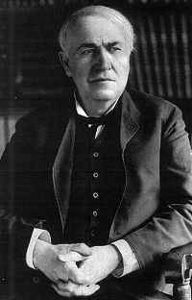
The Second Industrial Revolution
The constant stream of innovation triggered by the Industrial Revolution led to a “Second Industrial Revolution” in the late 19th century. This was based on improvements in the chemical, steel, and petroleum industries, and by the production of electricity. Thomas Edison (1847-1931) developed the phonograph, motion pictures, and the electric light bulb in the 1870s – inventions based on electricity.

Slide 38
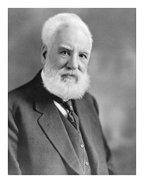
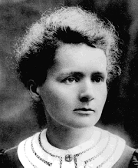
The Second Industrial Revolution, cont’d
Alexander Graham Bell invented the telephone in 1876.
Other inventors developed internal combustion engine – an engine running on petroleum-based gasoline. Scientists like Polish-born Marie Curie (1867-1934) also started studying radioactivity. She became the first woman to win a Nobel Prize for her discovery of radium.

Slide 39
The Impact of Industry on Nationalism
In the last chapter, you learned how the French Revolution and Napoleon unleashed the forces of nationalism. In the first half of the 19th century, conservative statesmen, like Prince Metternich managed to contain nationalist forces. Industrialization strengthened the power of the middle classes, who demanded national independence and unity in many places across Europe. Business leaders especially hoped to benefit from unified national markets. Skillful politicians and journalists also channeled worker discontent into nationalism.

Slide 40
The Unification of Italy and Germany
Following the failure of the Revolutions of 1848 in Italy and Germany, statesmen like Count Cavour in Italy and Otto von Bismarck in Germany managed to unify their nations through skillful diplomacy and the use of force.

Slide 41
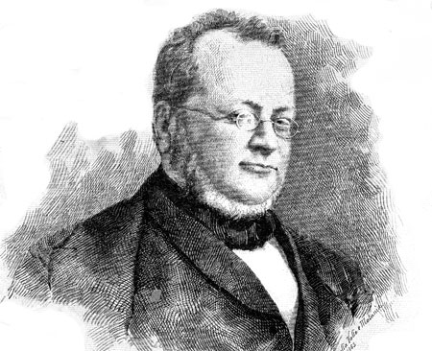
Italy (1859-1860)
For centuries, Italy had consisted of a number of smaller states. Nationalists called for a unification of Italy into a single country. Count Camillo di Cavour (1810-1861) was Prime Minister of the state of Piedmont in Northern Italy. He became famous by writing an essay on railroads. In the new industrial age, railroads could help unite Italy economically. Cavour enlisted French support to defeat Austria, driving the Austrians out of Northern Italy. Cavour next annexed Northern and Central Italy to the Kingdom of Piedmont.

Slide 42
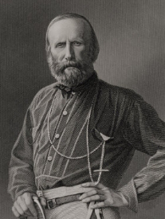
Italy (1859-1860), cont’d
The nationalist leader Giuseppe Garibaldi, along with his secret revolutionary society, overthrew the unpopular Kingdom of the Two Sicilies (Naples). Garibaldi agreed to join this area to Cavour’s enlarged Piedmont. By 1860, Italy had become a united nation. The ruler of Piedmont became the first King of Italy.

Slide 43
Germany (1863-1871)
Like Italy, Germany still consisted of a number of smaller states. Chief rivals for the leadership of Germany were the two largest German states – Prussia and Austria. Austria contained many non-German lands and people. The leaders of Austria did not want to see Germany united, since Austria could not bring its non-German territories into Germany.

Slide 44
Germany (1863-1871), cont’d
Economics strengthened Prussia’s hand. Prussia organized the German states into a customs union (known as Zollverein). Other German states adapted their economies to Prussia. Then Prussia’s Chancellor, Otto von Bismarck, followed a policy of “blood and iron” to unite Germany. Liberals failed to unite the German states in 1848; now Bismarck achieved unification through Prussia’s economic and military power.

Slide 45
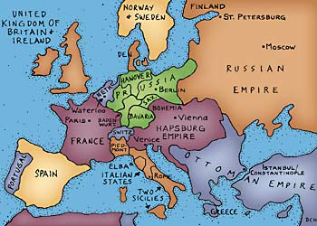
Germany (1863-1871), cont’d
Prussia had industrialized faster than Austria and France. Bismarck combined skillful diplomacy and Prussian military might to achieve German unification. Prussian military leaders made use of new technologies, like the railroad and the rifle, to build the most powerful army in Europe.

Slide 46
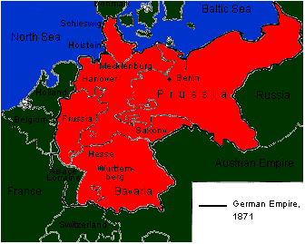
Germany (1863-1871), cont’d
After a series of successful wars against Denmark, Austria, and France, Germany was finally united in 1871. The King of Prussia became Kaiser (emperor) of Germany.

Slide 47
Industrial Revolution - Summarized

