Slide 1
The Islamic World and Africa
Ms. Anderson
World History

Slide 2
The Rise of Islam
In the fifth century, warfare between the Byzantine and Persian Empires interrupted over land trade routes from East Asia. Trade in spices, Chinese silks, and Indian cottons shifted to the sea routes connecting India with Arabia and the Red Sea. Overland caravans carried goods up the western coast of the Arabian Peninsula. Cities and towns developed near wells along these caravan routes.

Slide 3
The Rise of Islam, cont’d
Mecca was one of the most important of these cities. In the seventh century, a new religion emerged here: Islam. “Islam” is Arabic for “submission.” Within a hundred years, Islam grew to control an area larger than the Roman Empire.

Slide 4
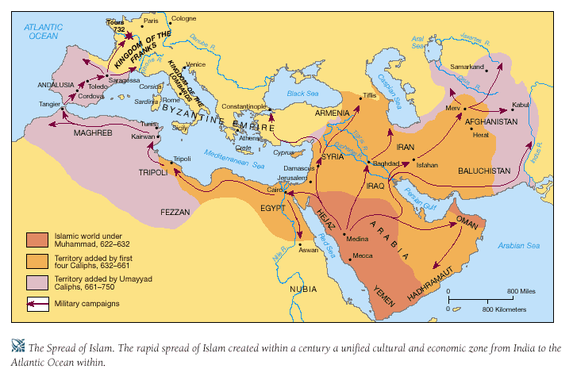
The Rise of Islam, cont’d

Slide 5
Mohammed: The Prophet of Islam
Islam was founded by Mohammed. Born in 570, he worked in Mecca as a merchant and a shepherd. He had a religious nature and often meditated in a nearby cave. One day, Mohammed had a vision that the Angel Gabriel commanded him to convert the Arab tribes, who then believed in many gods, to belief in a single God, known in Arabic as “Allah.”

Slide 6
Mohammed: The Prophet of Islam
This Allah was the same God worshipped by Jews and Christians. After his vision, Mohammed started to preach belief in Allah to his neighbors in Mecca.
Some merchants in Mecca grew envious of Mohammed’s growing influence. Fearing for his life, Mohammed fled to the city of Medina in 622. This event, known as the Hegira, marks the starting point of the Muslim calendar.

Slide 7
Mohammed: The Prophet of Islam
In Medina, Mohammed became a popular religious leader. He gathered an army to retake Mecca in a jihad, or “holy war.” In 632, two years after recapturing Mecca, Mohammed became ill and died. By the time of his death, most tribes of the Arabian Peninsula had united and converted to Islam.

Slide 8
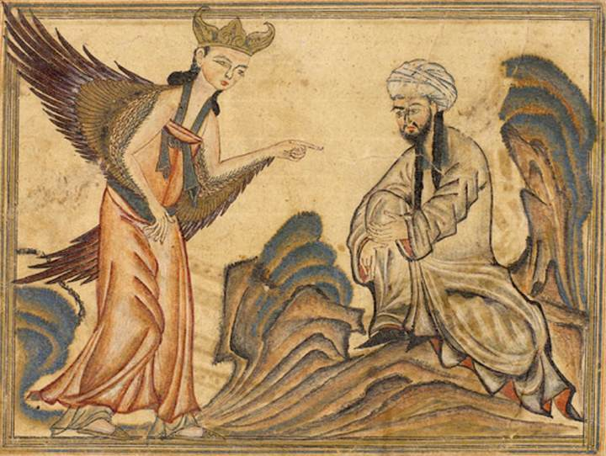
Mohammed: The Prophet of Islam
Mohammed being visited by the Angel Gabriel

Slide 9
The Quran (Koran)
The Quran (Koran) is the sacred text of Islam. Muslims believe it records the words revealed to Mohammed by God. Mohammed memorized these words and taught them to his followers. The scribes wrote these words down in the Quran. The Quran contains many references to both Jews and Christians. Its 114 chapters also discuss forms of worship, proper conduct, and the treatment of women, along with many other matters.

Slide 10
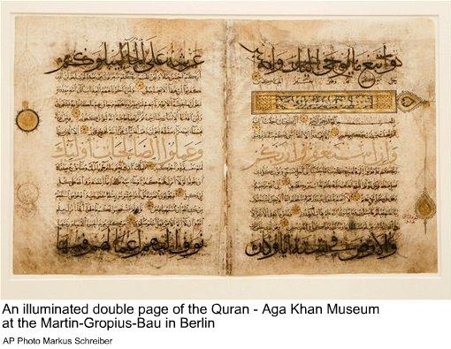
The Quran (Koran)
The fundamental doctrine of the Quran is contained in two articles of belief: “There is no God but Allah; and Mohammed is his prophet.”

Slide 11
The Five Pillars of Islam
In contrast to some religions, Muslims worship God directly without the intercession of a priest or clergy. The Five Pillars of Islam – faith in one God (monotheism), prayer, charity, fasting, and pilgrimage – make up the basic religious duties that all Muslims must fulfill. In so doing, Muslims strengthen their faith in and service to Allah, whom they see as the supreme, all-powerful, all-knowing God.

Slide 12
The Five Pillars of Islam
Confession of Faith
Muslims must affirm: “There is no God but Allah, and Mohammed is his prophet.”

Slide 13
The Five Pillars of Islam
Prayer
Muslims must pray 5 times a day, while facing the east towards the city of Mecca.

Slide 14
The Five Pillars of Islam
Charity
Muslims must give money to the poor and pay taxes to the Mosque.

Slide 15
The Five Pillars of Islam
Fasting
During the month of Ramadan, Muslims cannot eat or drink during daylight hours.

Slide 16
The Five Pillars of Islam
Pilgrimage
If physically able, a Muslim must make a pilgrimage (religious trip) to Mecca.

Slide 17
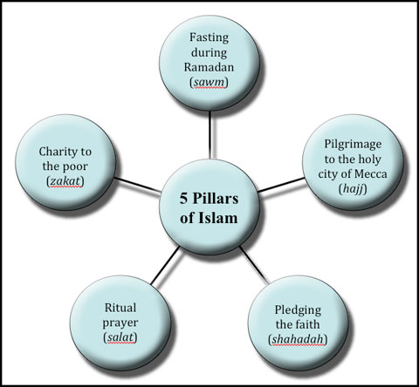
The Five Pillars of Islam

Slide 18
The Islamic Religion Spreads
Islam united the various Arab tribes with a common language (Arabic) and religion. Strengthened by their newfound unity, they set out on a “holy war” against non-believers. The Arabs were experienced fighters who fought with enthusiasm to gain entry into heaven.

Slide 19
The Islamic Religion Spreads
In contrast, by this time the Byzantines and Persians were both weakened from centuries of fighting with each other. Over the next century, Arab Muslims succeeded in creating a vast empire that extended from the Indus valley into Europe as far west as Spain. Muslim expansion in Europe was only halted at the Battle of Tours.

Slide 20
The Caliphates
When Mohammad died, a group of Muslim leaders chose a new leader, whom they called a caliph, or “successor to Mohammed.” Two of the early caliphs were murdered. A new caliph then founded the Umayyad Caliphate. Most Muslims, known as Sunnis, followed the new caliph. A small group of Shiite Muslims decided that only Mohammed’s descendants could be caliphs. The division between the Sunnis and Shiites remains to this day.

Slide 21
The Caliphates
Under the Umayyad caliphs, the capital of the Arab Empire was moved to Damascus (in present day Syria). After 750, a new family, the Abbasids, took over the caliphate. The Abbasids focused on trade rather than war, and built a new capital at Baghdad (in present day Iraq). The Abbasid caliph governed as an absolute ruler and surrounded himself with a rich court.

Slide 22
The Caliphates
As Islam expanded, the caliphs converted or enslaved other peoples they found worshipping many gods. At first, non-Arab converts to Islam had less rights than Arabs, but eventually all Muslims were treated equally. Muslim rulers treated Jews and Christians with respect since they were believed to worship the same God. They were permitted to have self-governing communities. However, Jews and Christians had to pay a special tax and could not hold some public offices.

Slide 23
The Golden Age of Muslim Culture
While learning was in decline in Western Europe, a Golden age of Muslim Culture flourished – a period of great advances in culture and technology. Arab Muslims absorbed the cultural achievements of the Greeks, Persians, Romans, Jews, and Byzantines.

Slide 24
The Golden Age of Muslim Culture
They also controlled a vast trading area – larger than the ancient Roman Empire had been. The new Arab Empire, like the Byzantine Empire before it, served as a crossroads for trade. Goods from India, China, Africa, Spain, and the eastern Mediterranean entered through Arab territories. This period also saw Arabic, the language of the Quran, achieve standardized use throughout the empire and become the language of literature , philosophy, and art.

Slide 25
The Golden Age of Muslim Culture
The prosperous Islamic Empire attracted invaders from Central Asia. In the 11th century, Baghdad was captured by the Seljuk Turks – a Turkish tribe from Central Asia. Although conquerors, the Seljuk Turks converted to Islam. Baghdad remained the capital of their new empire.

Slide 26
The Golden Age of Muslim Culture
In the 12th century, Muslims became engaged in a war with Christians over control of the Holy Land, known as the Crusades. Christians captured Jerusalem in 1099, but the city was later retaken by the Muslim leader and warrior, Saladin (1137-1193). Until this day, he remains a hero to the Islamic world for uniting the Arabs and defeating the Crusaders in battle.

Slide 27
Arab Cultural Achievements
Mathematics
Arab scholars borrowed the concept of zero from India and developed Arabic numerals, which were eventually adopted by other cultures. These developments led to great advances in algebra and geometry.

Slide 28
Arab Cultural Achievements
Arts And Crafts
Mohammed forbade making images of God or people. Islamic art is largely made up of geometric designs, flowers, and stars. Their textiles, leather works, and rugs are highly prized.

Slide 29
Arab Cultural Achievements
Medicine
Arab doctors discovered that blood moves to and from the heart. They learned to diagnose many diseases, including measles and smallpox.

Slide 30
Arab Cultural Achievements
Architecture
Muslim rulers built beautiful palaces and mosques, richly decorated with mosaics, calligraphy, and geometrical designs.

Slide 31
The Kingdoms of Africa
Anthropologists believe humanity first arose in East Africa. In ancient times, the rise of Egyptian civilization affected African cultures along the upper Nile, such as the Kush and Axum. Kush was an early iron-producing center, which grew rich from selling iron wares, ivory, ebony, wood, and slaves. Later, the Kingdom of Ethiopia in East Africa adopted its own form of Christianity.

Slide 32
The Gold-Salt Trade
The dry Sahara Desert occupies most of North Africa. Just below this desert is a wide band of grasslands with some trees, known as the savanna. The savanna stretches across almost the entire width of Africa, from the Atlantic to the Indian Ocean. It was home to large numbers of pastoral peoples herding cattle and sheep. These people also learned to smelt iron and grow crops, and had complex communities with craftpersons, warriors, and traders. Below the savanna lay the tropical rainforests of equatorial Africa.

Slide 33
The Gold-Salt Trade
The Sahara Desert acted as a barrier that separated the peoples of Sub-Saharan Africa from the Mediterranean world and the rest of Eurasia. Despite this separation, trade across the Sahara was never cut off completely. The Sahara contains oases with underground springs that supply fresh water. Because camels are able to go several days without water, merchants could cross the desert once they knew where these oases were located. By the 7th century, Muslim merchants from the Mediterranean were making the challenging journey.

Slide 34
The Gold-Salt Trade
These merchants were especially motivated to cross the Sahara because of the gold and other riches they could obtain from trade with West Africa. At the same time, part of West Africa lacked salt – vital to human survival. Merchants, moving in camel caravans across the desert, picked up large blocks of salt on their journey, to exchange for gold. A thriving trade developed, based on this gold-salt trade. Ideas were exchanged, such as Islamic beliefs, as well as goods.

Slide 35
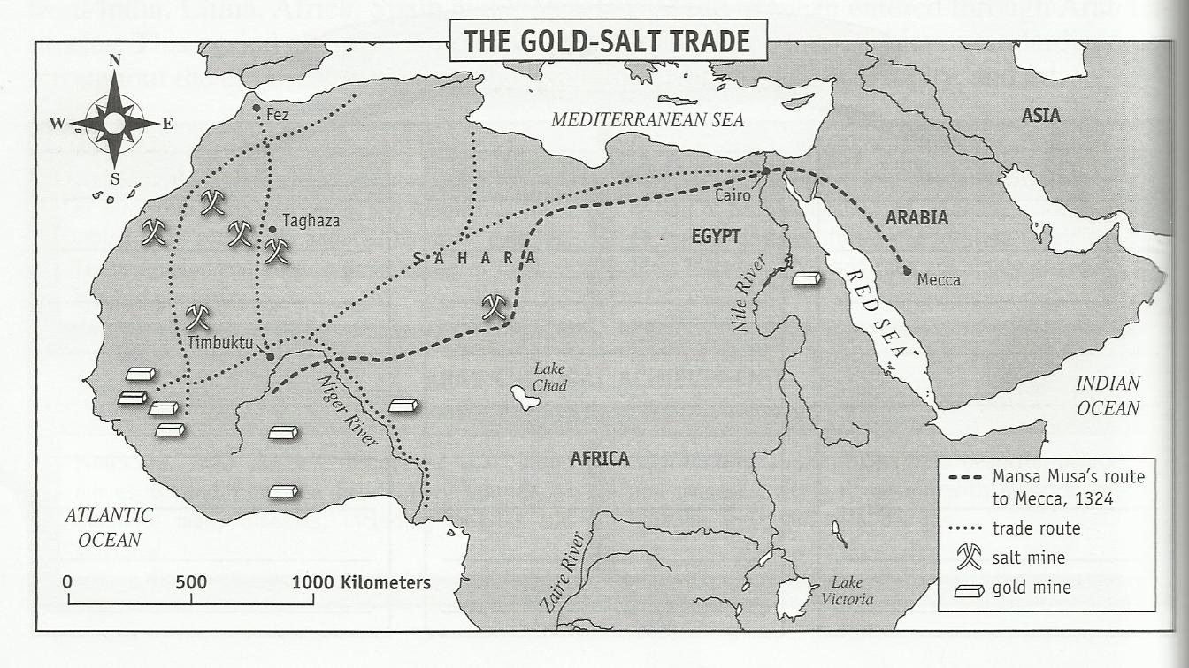
The Gold-Salt Trade

Slide 36
Rise of the West African Kingdoms
Around the fifth century, West Africa saw the rise of a series of powerful kingdoms based on their control of trade routes and fine cavalries. For the next thousand years, their civilizations dominated West Africa – leading to an exchange of ideas, the rise of cities, and increasing wealth.

Slide 37
Kingdom of Ghana (750-1200)
The Kingdom of Ghana was founded about 750. It developed in the region between the Senegal and Niger Rivers. The people of Ghana used their ability to make iron swords, spears, and lances to subdue neighboring peoples and to gain control over West Africa’s major trade routes. Caravans brought salt south to Ghana and returned north with gold from forest areas southwest of Ghana. The power of the kings of Ghana rested on their ability to tax all trade passing through the region, especially the salt and gold trade. With these revenues, they were able to raise an army with a large cavalry.

Slide 38
Kingdom of Ghana (750-1200)
The rulers of Ghana built a capital city and governed a wide area through the use of officials and nobles. The king appointed nobles to govern the provinces in return for paying taxes to the central government. This system had some similarities with European feudalism. Rulers and nobles were further enriched by using captives of war as slaves. However, in 1076, the Ghanaians were invaded by Muslims from North Africa. The Muslims brought Islam to West Africa. Ghana never fully recovered from this invasion and eventually dissolved into several smaller states.

Slide 39
Kingdom of Ghana (750-1200)

Slide 40
Kingdom of Ghana (750-1200)

Slide 41
Kingdom of Mali (1240 – 1400)
In 1240, the people of Mali conquered the old capital of Ghana and established a new empire. Their rulers brought both gold and salt mines under their direct control. Mali’s rulers converted to Islam, although most of their people did not adopt the Islamic faith and stayed loyal to traditional religious beliefs.
Mali’s most famous ruler, Mansa Musa, expanded the kingdom greatly. He made a religious pilgrimage to Mecca in 1324, also visiting Cairo in Egypt. Observers were impressed with his wealth. Mansa Musa brought Muslim scholars and architects back with him to Mali.

Slide 42
Kingdom of Mali (1240 – 1400)
Mansa Musa commissioned a palace and a giant mosque to be built in Timbuktu, a thriving trading center on the Niger River. Under Musa’s support, Muslim scholarship flourished. Timbuktu became an important center of several important universities and attracted students from Europe, Asia, and Africa. Because of the importance of studying the Quran, many of the subjects learned to read and write.

Slide 43
Kingdom of Mali (1240 – 1400)

Slide 44
Kingdom of Mali (1240 – 1400)
Arab travelers like Ibn Battuta were impressed by Mali’s wealth, respect for law and the power of its ruler. It is through the extensive travels of Ibn Battuta during this time period that scholars know much about the life in Africa and the Middle East. Later rulers of Mali proved less capable than Mansa Musa, and the empire collapsed in the 1400s.

Slide 45
Kingdom of Mali (1240 – 1400)

Slide 46
The Kingdom of Songhai (1464- 1600)
In 1464, Sultan Sunni Ali, ruler of the Songhai people, captured Timbuktu and brought the upper Niger under his control. The Kingdom of Songhai became the largest of West Africa’s three trading kingdoms. Like Ghana and Mali, Songhai grew rich from trade across the Sahara Desert. Songhai expanded its trading networks as far as Europe and Asia. The Songhai established an elaborate system of taxation and communications. Timbuktu continued to flourish as a center of Muslim scholarship, and many subjects were Muslim.

Slide 47
The Kingdom of Songhai (1464- 1600)
Despite its riches and power, the Kingdom of Songhai lasted only 130 years. In 1591, the ruler of Morocco, hearing of Songhai’s wealth, invaded West Africa. Although the Songhai army was larger, the Moroccans used gunpowder and muskets to defeat the Songhai, who fought with arrows and spears. Despite their military success, the Moroccans were unable to govern Songhai from such a great distance. West Africa again split apart into a large number of independent areas. The fall of Songhai marked the end of the great West African kingdoms.

Slide 48
The Kingdom of Songhai (1464- 1600)

Slide 49
Other African States
The growth of trading kingdoms in the West African savanna, like Ghana, Mali, and Songhai, was matched by the rise of trading kingdoms in other parts of Africa.

Slide 50
Other African States
Ife and Benin –
These kingdoms developed in the rainforests of West Africa. They became famous for their copper and bronze sculptures, which were among the finest of all African artwork. By the 16th century, Benin became involved in the slave trade. It traded captured persons from other tribes and exchanged them with Europeans for guns and iron goods.

Slide 51
West African Rainforest

Slide 52
Other African States
Zimbabwe –
Further to the south, Zimbabwe was one of the best known of Africa’s trading kingdoms. The existence of gold deposits near Zimbabwe was crucial to its rise. It traded gold, copper, and ivory from Africa’s interior with Muslim traders along Africa’s east coast.
Coastal Cities of East Africa –
Along the east coast of Africa, a number of independent city-states arose around the 10th century. Gold from the African interior was sent down the Zambia River to these cities, where it was sold to merchants from Arabia to India.

Slide 53
Other African States

Slide 54
Family Roles in Africa
In many traditional African societies, both boys and girls were separated from the community and underwent special ceremonies at puberty. Marriages were arranged by families, and the groom paid a dowry to his bride’s family. Under Islam, women were limited to running the household while their husbands represented the family outside it. Their roles were summed up by a traditional Ghanaian proverb: “A woman is a flower in a garden; her husband is the fence around it.”

