Slide 1
Human Geography of Africa:
From Human Beginnings to New Nations
Africa is the “cradle of humanity” and has been home to numerous empires. But today, its people’s lives are most affected by Africa’s colonial history.

Slide 2
Human Geography of Africa:
From Human Beginnings to New Nations
SECTION 1
East Africa
SECTION 2
North Africa
SECTION 3
West Africa
SECTION 4
Central Africa
SECTION 5
Southern Africa

Slide 3
Section-1
East Africa
East Africa is known as the “cradle of humanity.”
East Africa’s location has made it a trading center.

Slide 4
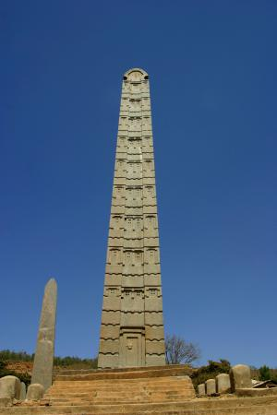
Section-1
East Africa
Continental Crossroads
Cradle of Humanity
Prehistoric human remains found in Olduvai Gorge, Tanzania
A Trading Coast
Region includes Burundi, Djibouti, Eritrea, Ethiopia, Kenya
− Rwanda, Seychelles, Somalia, Tanzania, Uganda
In A.D. 100s, Ethiopian civilization of Aksum trades with Egypt, Rome
In 600s, Arabs, Persians, Indians trade in region
− important Tanzanian trading city of Kilwa flourishes
Area becomes cultural crossroads of goods, ideas, people

Slide 5
Colonization Disrupts Africa
Scramble for Africa
19th-century Europeans seek African resources
− 1884–85 Berlin Conference divides Africa; African input denied
Ethiopia Avoids Colonization
Emperor Menelik II protects Ethiopia from Italian invasion in 1896
Conflict in East Africa
Independent by 1970s, many countries suffer civil wars, disputes
− colonial boundaries mix ethnic groups, lead to internal conflicts

Slide 6
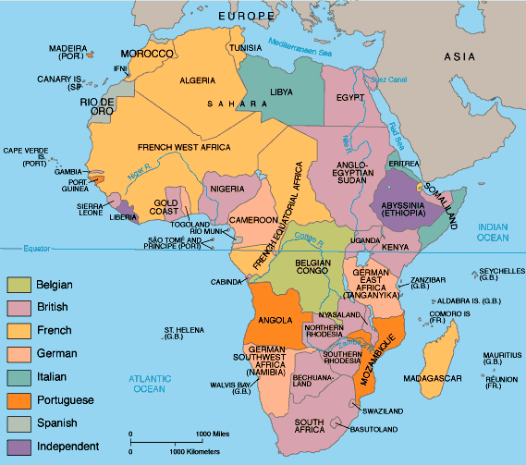

Slide 7
Farming and Tourism Economies
Farming in East Africa
Countries grow cash crops for direct sale (coffee, tea, sugar)
− such crops take up farmland needed for growing food
People leave farms for cities like Addis Ababa, capital of Ethiopia
− rapid urban growth strains resources, agricultural production
Tourism Creates Wealth and Problems
Wildlife parks in Kenya, Uganda, Tanzania attract tourists, income
− need for food, farmland is threatening wildlife reserves

Slide 8
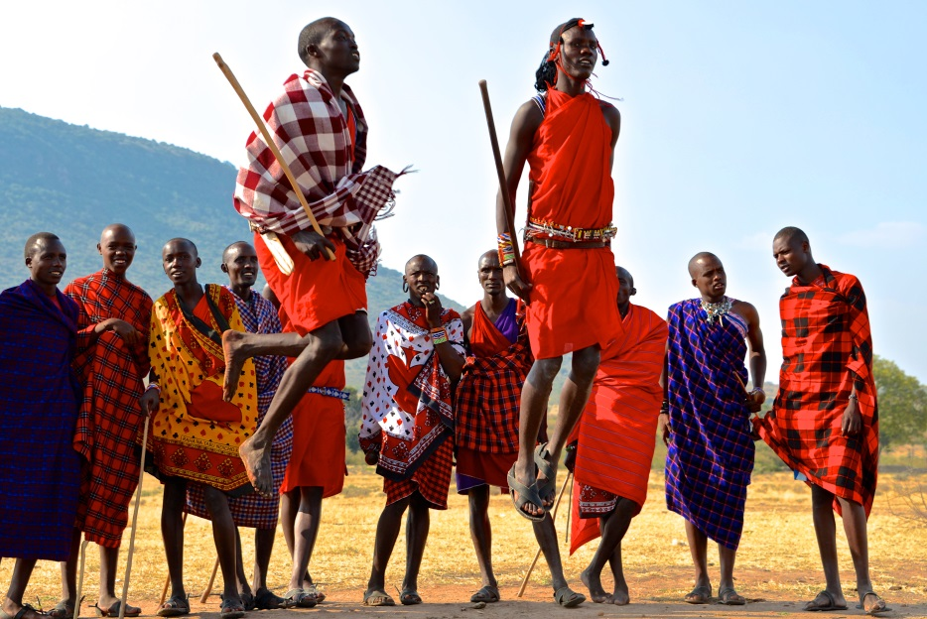
Maintaining Traditional Cultures
Cultures of East Africa
160 different ethnic groups in region
Masai live in rift valley grasslands of Kenya, Tanzania
− herd livestock, farm, make intricate beadwork, jewelry
− wear calfskin, buffalo-hide clothes, robes
Kikuya are largest Kenyan ethnic group, centered around Mount Kenya
− in 1950s they organized Mau Mau society to fight British
− British kill 11,000 Africans during Mau Mau rebellion

Slide 9
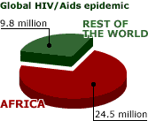
Health Care in Modern Africa
Health Care in Africa
Africa devastated by AIDS pandemic
− pandemic—disease outbreak in large population over a wide area
AIDS caused by human immunodeficiency virus (HIV)
− more people have HIV than AIDS, so AIDS numbers are misleading
Some African governments hide scope of disease
Experts fear worst-affected countries could lose 10-20% of populations

Slide 10
Section-2
North Africa
The Nile River valley and ancient Egypt, one of the world’s great civilizations, formed a cultural hearth.
North Africa shares the Arabic language and the Islamic religion and culture with Southwest Asia.

Slide 11
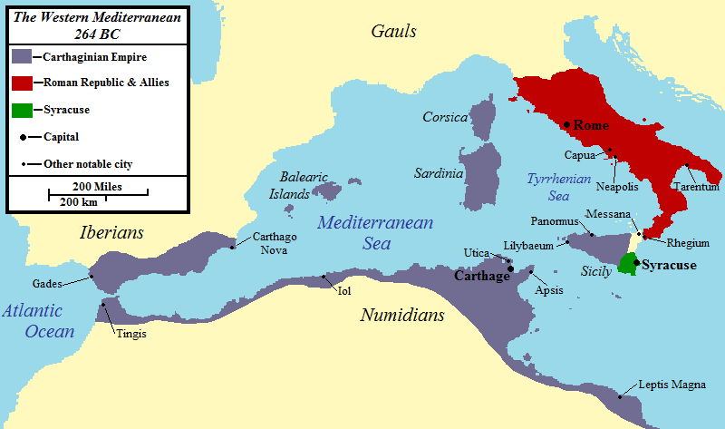
Section-2
North Africa
Roots of Civilization in North Africa
North African Countries
Algeria, Egypt, Libya, Morocco, Sudan, Tunisia
Egypt Blossoms Along the Nile
Nile’s flooding provides water, rich soil, to help civilization grow
Nile villages united into first Egyptian dynasty around 3100 B.C.
− Pharaohs rule Egypt for 2,600 years
Egyptian geometry and medicine are spread by trade
Carthage
Legend says great ancient city of Carthage was founded in 814 B.C.
− location on Gulf of Tunis peninsula make it a trade center
Continued…

Slide 12
Roots of Civilization in North Africa {continued}
Islam in North Africa
Over time, invaded by Greeks, Romans, Phoenicians, Ottoman Turks
Islam is main cultural, religious influence
− monotheistic religion based on Muhammad’s teachings
Southwest Asian Muslims invade North Africa in A.D. 632
− take Egypt in 634; control whole region by 750
Muslims bind territory with sea-linked trade zones

Slide 13
Economics of Oil
Black Gold
Oil has replaced cash crops, mining as economic base
− transformed economies of Algeria, Libya, Tunisia
Oil also causes problems
− Libya’s workforce lacks training, education to work in oil industry
− high-paying oil jobs go to foreign workers
− despite oil, unemployment remains high
− Libyan workers migrate to Europe for jobs

Slide 14
A Culture of Markets and Music
North African Souks
Souks (marketplaces) are located in the medina (old section of town)
− best are in Marrakesh, Morocco
− high-pressure sales and fierce bargaining over clothes, spices, food
Protest Music
Rai—fast-paced Algerian music is developed in 1920s by urban youth
− before independence in 1962, rai expresses anger at French colonizers
− today, rai is criticized by Islamic fundamentalists for Western style
− rai now a form of rebellion against Islamic fundamentalists

Slide 15
Changing Roles of Women
Women and the Family
Homes are centered around males, few women work after marriage
Women’s roles are changing, especially in Tunisia
− multiple wives are prohibited; both spouses can seek divorces
− high spouse-abuse penalties; no more arranged marriages for young girls
More women have professional jobs, with equal pay for equal jobs
− hold 7% of Tunisian parliamentary seats
− manage 9% of businesses in Tunis, Tunisia’s capital

Slide 16
Section-3
West Africa
The Nile River valley and ancient Egypt, one of the world’s great civilizations, formed a cultural hearth.
North Africa shares the Arabic language and the Islamic religion and culture with Southwest Asia.

Slide 17
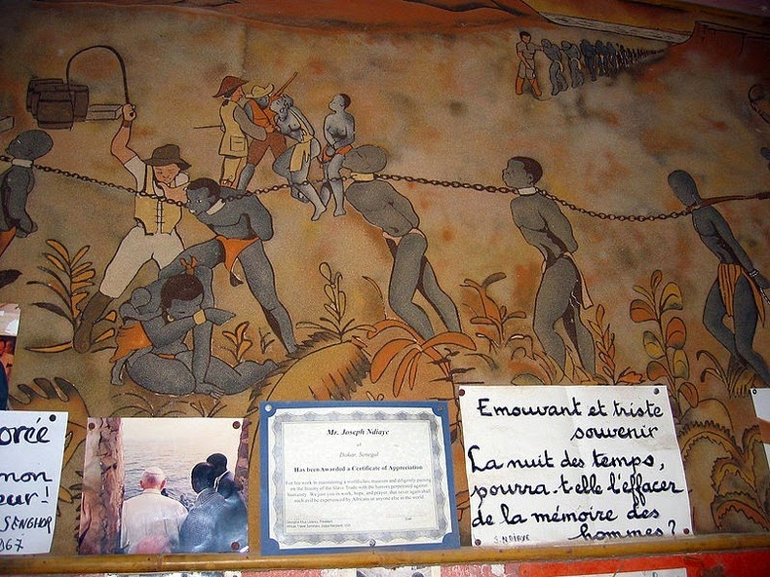
Section-3
West Africa
A History of Rich Trading Empires
The Slave Trade
Gorée Island off coast of Senegal
− departure point for slaves during slave trade, mid-1500s to mid-1800s
− Europeans moved 20 million Africans through the island
− 20% of Africans died in transit to the Americas
West African Countries
West Africa includes Benin, Burkina Faso, Cape Verde, Chad
− Cote d’Ivoire, Gambia, Ghana, Guinea, Guinea-Bissau, Liberia, Mali
− Mauritania, Niger, Nigeria, Senegal, Sierra Leone, Togo
Continued…

Slide 18
A History of Rich Trading Empires {continued}
Three Trading Empires
Ghana, Mali, Songhai empires grow on Sahara trade routes (gold, salt)
Routes cross Sonike farms; Sonike leaders called ghana (war chief)
− area becomes known as Ghana; taxing traders creates Ghana’s wealth
− Ghana becomes empire around A.D. 800, declines by 1100
Kingdom of Mali rises by 1235; conquers Ghana, dominates gold trade
− by 1440, gold trade falls—other gold fields are found further east
By 1400, Mali is replaced by Songhai, until Morocco invades in 1591
Continued…

Slide 19
A History of Rich Trading Empires {continued}
Stateless Societies
Stateless society—people rely on family lineages to govern themselves
− no elected government or monarch; members cooperate, share power
− lineage—family or group descended from common ancestor
− for example, the Igbo of southeast Nigeria
1700–1800s, African stateless societies are challenged by colonizers
− Europeans expect societies to be governed by single ruler

Slide 20
West Africa Struggles Economically
Ghana’s Stability
Exports gold, diamonds, magnesium, bauxite to industrialized countries
− second highest per capita income in West Africa
Post-colonial switch to democracy brought military rule, civil war
− past decade’s free elections and political stability grow the economy
Problems in Sierra Leone
Once produced high-quality diamonds, but civil wars destroyed economy
Low 31% literacy rate means few skilled workers
Poor transportation system, few highways and roads

Slide 21
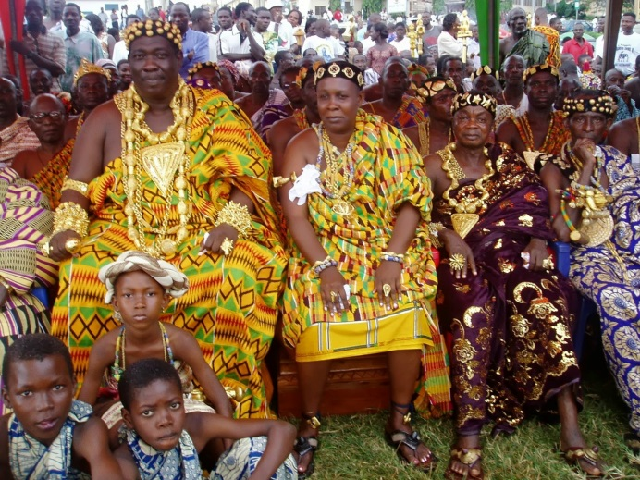
Cultural Symbols of West Africa
Ashanti Crafts
Ghana’s Ashanti known for weaving asasia (kente) cloth
− cloth has colorful, meaningful designs; once worn only by royalty
Carved stools symbolize unity between ancestral spirits and the living
− kings’ stools represent unity between state and people
Benin Art
Kingdom of Benin arose in Nigeria area in 1200s
Artists made metal and terra cotta objects
− brass “bronzes” included statues, masks, jewelry

Slide 22
Music in Daily Life
West African Music
Popular music blends traditional with jazz, blues, reggae
− often use French, English lyrics to attract international audience
Played on drums and instruments like the kora
− kora, from Guinea-Bissau, a cross between harp, lute
Nigeria’s “minister of enjoyment,” King Sunny Adé, is very popular

Slide 23
Section-4
Central Africa
The Bantu migrations helped to populate the African continent.
European nations divided Africa without regard to ethnic groups or language.

Slide 24
4
Section-4
Central Africa
Bantu Migrations and Colonial Expansion
Central African Countries
Cameroon, Central African Republic, Democratic Republic of the Congo
Republic of Congo, Equatorial Guinea, Gabon, São Tomé and Princípe
Bantu Migrations
Bantu migrations—2000 B.C., Bantu spread from southeastern Nigeria
− land shortage may have sent them south spreading language, culture
Migrations created cultural diversity, but languages link continent
− forms of Bantu spoken by 120 million Africans today
Continued…

Slide 25
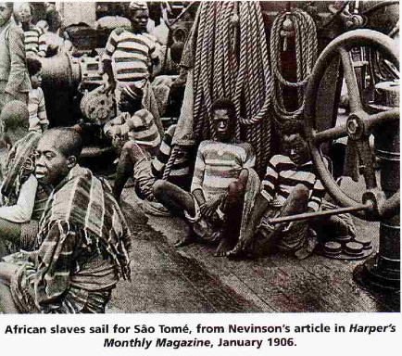
Bantu Migrations and Colonial Expansion {continued}
The Slave Trade
Europeans wanted slaves for plantations in Americas
In 1400s, Portugal established base on island of São Tomé off Gabon
− slave traders exchange guns, goods for captive Africans
Many African rulers sold slaves to other Africans, Arabs, Europeans
By end of trade in 1870, millions had been taken to Americas, Europe
Continued…

Slide 26
Bantu Migrations and Colonial Expansion {continued}
Start of Colonialism
Until mid-1800s, Europeans don’t move far inland
Belgium’s King Leopold II opens Congo trade, controls interior by 1884
− holds Berlin Conference, forms Congo Free State
− uses forced labor to get rubber, palm oil, ivory
Effects of Colonialism
Belgium, France colonize region; most countries independent by 1960s
− European borders disrupt traditional governments, ethnic regions
− new governments face diverse populations, corrupt leaders

Slide 27
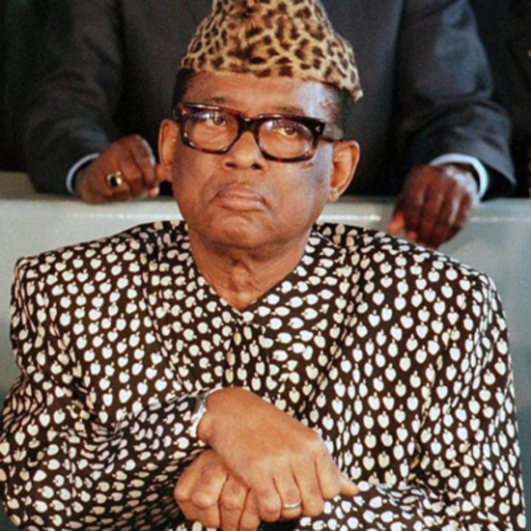
The Economic Legacy of Colonialism
Economic Effects
Lost resources; cultural, ethnic oppression of people
Little infrastructure or money for transportation, education systems
Congo’s Economic Chaos
Democratic Republic of the Congo has gold, copper, diamonds
From 1967, Mobuto Sese Seko runs businesses, uses army to keep power
Laurent Kabila replaces Mobutu in 1997; neighbors send in troops
− Angola, Namibia, Zimbabwe, Rwanda, Uganda want land, resources
− Kabila assassinated in 2001, succeeded by son Joseph

Slide 28
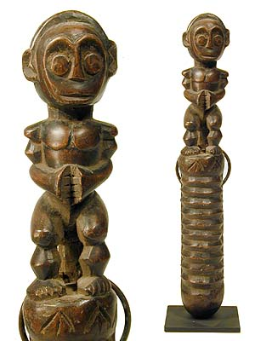
The Influence of Central African Art
Central African Art
Since independence, many countries banned colonial influences
− sought to recover African personality in art
Today, artists address politics, urban life, social justice, crime
Fang Sculpture
In 1907, Pablo Picasso was influenced by Fang sculpture
Fang of Gabon, Cameroon, Equatorial Guinea are famous for carving:
− wooden masks painted white with black-outlined features
− boxes for ancestors’ bones; decorated with protective figures

Slide 29
Improving Education
Education Faces Barriers
In 2001, less than half the sub-Saharan young adults attend school
− shortage of teachers and secondary schools, high dropout rate
Language problems: different languages spoken in homes, schools
Learning in Central Africa
In Cameroon, most children leave school at age 12
In Central African Republic, kids 6 to 14 are required to attend school
Cameroon, Gabon, Republic of the Congo are adding higher education
Health care education increasing: AIDS, Ebola virus, cholera, others

Slide 30
Section-5
Southern Africa
Great Zimbabwe and the Mutapa Empire thrived on the gold trade.
The wealth of Southern Africa is tied to the land, and conflicts over land and resources often result.

Slide 31
Section-5
Southern Africa
Gold Trade Builds Empires
Southern African Countries
Angola, Botswana, Comoros, Lesotho, Madagascar, Malawi, Mauritius
− Mozambique, Nambia, South Africa, Swaziland, Zambia, Zimbabwe
Gold Trade Spawns Great Zimbabwe
Great Zimbabwe—Shona form major gold-trading city 1000
− abandoned around 1450
Mutapa Empire
Legend says Mutota founded new state in 1440
− Mutapa Empire soon covered almost all of Zimbabwe
Thriving gold empire declines in 1500s amid Portuguese interference
Continued…

Slide 32
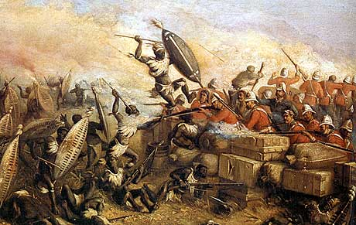
Gold Trade Builds Empires {continued}
Ethnic Clash for Southern Africa
In 1700s, 1800s, ethnic groups fight each other, Europeans for land
In late 1800s, British defeat Zulu, then Boers (Dutch farmers)
− form Union of South Africa in 1902
Continued…

Slide 33
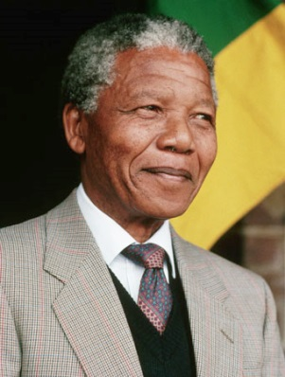
Gold Trade Builds Empires {continued}
The Policy of Apartheid in South Africa
In 1948, white minority government institutes apartheid
− complete separation of races in schools, hospitals, neighborhoods
− blacks make up 75% of population, but own little land
Blacks form African National Congress (ANC) in 1912 to seek rights
Nelson Mandela becomes an ANC leader in 1949, is later imprisoned
Continued…

Slide 34
Gold Trade Builds Empires {continued}
The Policy of Apartheid in South Africa
In late 1980s, under pressure from world, South Africa begins reform
− F.W. de Klerk becomes president in 1989
− peaceful revolution leads to end of apartheid in early 1990s
− Mandela is freed, elected president in 1994
− new, democratic constitution passes in 1996

Slide 35
Southern Africa Grows Economically
South Africa
Apartheid hurts economy, other nations impose economic sanctions
− majority of young blacks uneducated
Two economies in South Africa:
− upper-middle income in industrial cities like Johannesburg, Cape Town
− poor rural areas, black townships, shantytowns
Continued…

Slide 36
Southern Africa Grows Economically {continued}
Success at a Cost
Botswana became independent in 1966, had long-term economic growth
− world’s third-largest diamond producer
− diamonds account for 63% of government revenue
Diamonds make 20% rich, but 80% are farmers who don’t benefit
Rich buy land for cattle, force off farmers, increase meat production
− but overall food production is only 50% of what’s needed
Continued…

Slide 37
Southern Africa Grows Economically {continued}
AIDS Affects Southern Africa
Southern Africa has the countries most severely affected by AIDS
− 25% of adults infected in Zimbabwe, Botswana
− Botswana’s life expectancy is 39 years
− economy is affected as many diamond sorters die from AIDS

Slide 38
Celebrations of Southern Africa
A Variety of Dances
Chewa perform gule wa mkulu religious dance with skins, masks
Tumbuka of northern Malawi perform vimbuza healing dance
Benji dance of southern Malawi’s Yao warriors mocks European marches
Madagascar’s hira gasy festival features groups of 25 or more
− play music, dance, act out stories on honesty, respect for elders

Slide 39
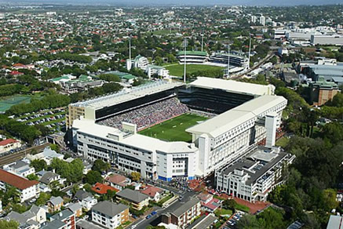
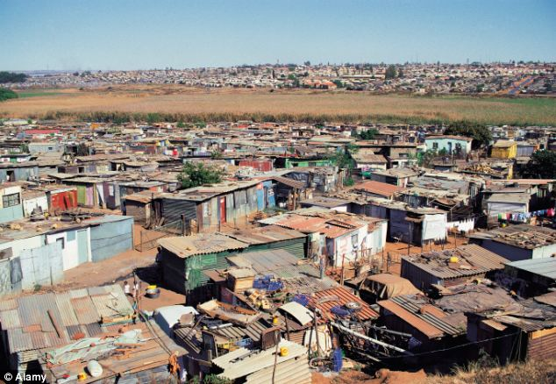
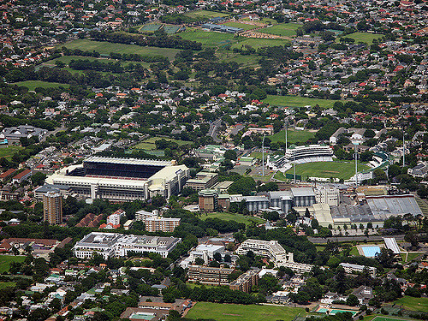
Living in Southern Africa
Johannesburg
Grew from small gold mining town 100 years ago to 6 million people
Because of apartheid, Johannesburg grew into two cities
− once all-white suburbs in north, poor black townships in south
Continued…

Slide 40
Living in Southern Africa {continued}
Modern and Traditional Lifestyles
Some live modern lives as doctors, lawyers, professionals in suburbs
Many blacks work menial jobs and live in homelands, shantytowns
Some ethnic groups keep traditional lifestyles
− work as farmers, traders, herders, metalworkers (like Zulu)

