Slide 1
PROCESSES SHAPING PLANET EARTH
What forces have helped shape Earth’s landforms, climate and plant life?

Slide 2
Earth and the Solar System
Chapter 2, Section 1

Slide 3
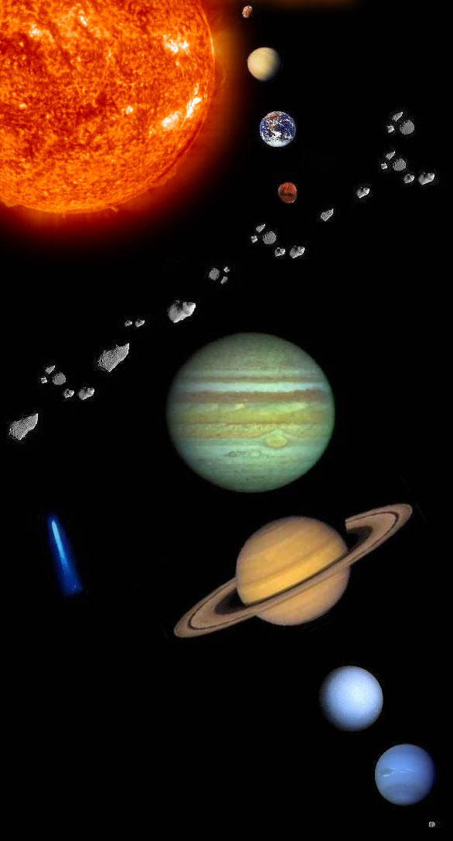
Solar System
Mercury
Venus
Earth
Mars
Jupiter
Saturn
Uranus
Neptune
Pluto

Slide 4
Structure of Earth
Inner Core - solid

Slide 5
Structure of Earth
Inner Core - solid
Outer Core - liquid

Slide 6
Structure of Earth
Mantle – has several layers
Magma created here.
Inner Core - solid
Outer Core - liquid

Slide 7
Structure of Earth
Crust – thin layer of rock
Mantle – has several layers
Magma created here.
Inner Core - solid
Outer Core - liquid

Slide 8
On and above the Earth
Atmosphere – air
Lithosphere – solid rock portion of the earth
Hydrosphere – All bodies of water
Biosphere – where plants and animals live (everything combined)

Slide 9
Continental Drift Theory
In 1912 Alfred Wegener presented a new idea about the continents. He called it the Continental drift theory. He maintained that the earth was once a supercontinent that divided and slowly drifted apart over millions of years.
Wegener called this supercontinent “Pangaea” meaning “all earth”.
The supercontinent split into many plates that drifted and crashed into each other and split apart before coming to their current position.

Slide 11
Lithosphere
The lithosphere is made up of Earth’s crust and solid upper mantle.
Below the Earth’s crust is the mantle, a region of hot, dense rock.
As one travels deeper toward Earth’s center temperature and pressure rises.

Slide 12
Tectonic Plates
The earth’s crust is broken up into tectonic plates. The movement of these plates shapes the earth’s surface.
New crust is made when plates spread apart. Crust folds into new mountain chains where continental plates collide.

Slide 13
“Plate Tectonic” Theory
Notes:
If you look at a map of the world, you may notice that different continents seem to fit together like a puzzle. Many scientists believe that all of the present continents of the world fit together in a single, giant continent. Gradually, this large land mass separated and its pieces drifted apart to their present locations.

Slide 15
WHAT CAUSES PLATE MOVEMENT?
CONVECTION – The spread of heat through the movement of a fluid substance. Inside the mantle, semi-solid rock is heated. As it is heated it expands and becomes less dense. This lighter rick rises as gravity pulls down the cooler dense rock.
GRAVITY – also contributes to plate movement. When oceanic plates and land plates collide the dense oceanic plate is pulled by gravity under the lighter land plate.

Slide 16
Convection is the spread of heat through the movement of a fluid substance.

Slide 17
WHAT ARE THE EFFECTS OF PLATE TECTONIC BUILDING?
Mountain Building
Seafloor Spreading
Rift Valleys
Earthquakes and Tsunamis
Volcanoes

Slide 18
Mountain Building
When two land plates slowly push into one another, they often fold upward, creating mountain chains.

Slide 19
The convergence of the Indian plate and the Eurasian plate created the Himalayan Mountains.

Slide 20
Andes Mountains were created when the continental plate of South America collided with the oceanic plate.

Slide 22
SEAFLOOR SPREADING
Some plates move apart. The separation of plates causes the seafloor to spread.
As the plates move apart, magma rises up through the cracks in the ocean floor creating a ridge of mountains or islands.

Slide 23
CREATION OF RIFT VALLEYS
The separation of tectonic plates has created rift valleys- long valleys between parallel ridges of mountains.
The Great Rift Valley in Africa runs through the highlands of Ethiopia and Kenya to the east.

Slide 24
THE GREAT RIFT VALLEY

Slide 25
EARTHQUAKES
Plate movements can cause a break in Earth’s crust, known as a fault.
As plates move, they create tremendous stress at plate boundaries. Eventually, parts of the rocky crust will break causing a fault and sending vibrations known as earthquakes.
Scientists measure the waves sent by an earthquake with a seismograph.

Slide 26
When an earthquake occurs under or near the ocean, it creates immense oceans of destructive force known as a tsunami.

Slide 27
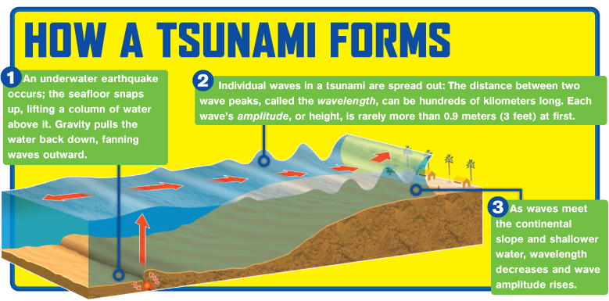

Slide 28
VOLCANOES
In places where tectonic plates diverge or where one dives under another, pressure in the Earth’s mantle is reduced and the hot, solid rock becomes liquid.
Pockets of molten rock form beneath the Earth’s surface and may break through the Earth’s crust.

Slide 29
VOLCANO ERUPTING

Slide 30
Ring of Fire is a zone of volcanoes and frequent earthquakes.

Slide 31
OTHER FORCES AFFECTING EARTH’S LITHOSPHERE
The processes of weathering and erosion reduce the mountains and other land features created by volcanoes, earthquakes and folding.

Slide 32
WEATHERING
The wearing down of rocks at the Earth’s surface by actions of wind, water, ice and living things.

Slide 33
Weathering by freezing
Water expands when it freezes. Water may seep into cracks or pores in rocks and expand these cracks or pores in rocks and expand these cracks if the temperature drops and the water freezes.

Slide 34
WEATHERING

Slide 35
EROSION
The process by which rock, sand and soil are broken down and carried away.

Slide 36
By erosion a river can cut a canyon, like the Grand Canyon, through solid rock.

Slide 37
DEPOSITION
The same forces that erode one place can deposit particles and sediment in another place building it up.
Example: rivers carry sediment down stream and ocean waves can bring sand to a beach.

Slide 38
Smaller rocks are displaced by water and deposited downstream. The water over the rocks in time make them smooth.

Slide 39
EARTH’S LANDFORMS
ALL THERE PROCESSES ACTING ON EARTH’S LITHOSPHERE CREATE TYPICAL LANDFORMS. THESE LANDFORMS INCLUDE MOUNTAINS, HILLS, PLATEAUS, VALLEYS, PLAINS, CANYONS, DESERTS AND BEACHES.

Slide 40
Mountains – formed by the collision of tectonic plates.

Slide 41
VALLEYS – long, low areas between ranges of mountains, hills or uplands. They are often created by erosion and may have stream running along bottom.

Slide 42
PLATEAU – a flat highland whose sides drop suddenly because of erosion.

Slide 43
CANYONS – a deep gorge or ravine between cliffs often carved from landscape by a river.

Slide 44
Hills – Landform that extends above the surrounding lands, often with slight summit.

Slide 45
Plains – Area of level land usually at low elevation and covered with grasses

Slide 46
DESERT- may be rocky or sandy. An area that received less than 9 inches of precipitation a year.

Slide 47
Archipelago – island chain

Slide 48
Bay – an area surrounded by land

Slide 49
Delta – flat, low land built up from soil carried downstream.

Slide 50
Gulf – a large body of water along a sea or ocean. – Gulf of Mexico.

Slide 51
Isthmus – narrow stretch of land connecting two large land areas.

Slide 52
Coast – the land along a sea or an ocean.

Slide 53
River – large natural stream of water that flows through land from high to low elevation.

Slide 54
Tributary – small stream or river that flows into a larger river.

Slide 55
Island – body of land completely surrounded by water.

Slide 56
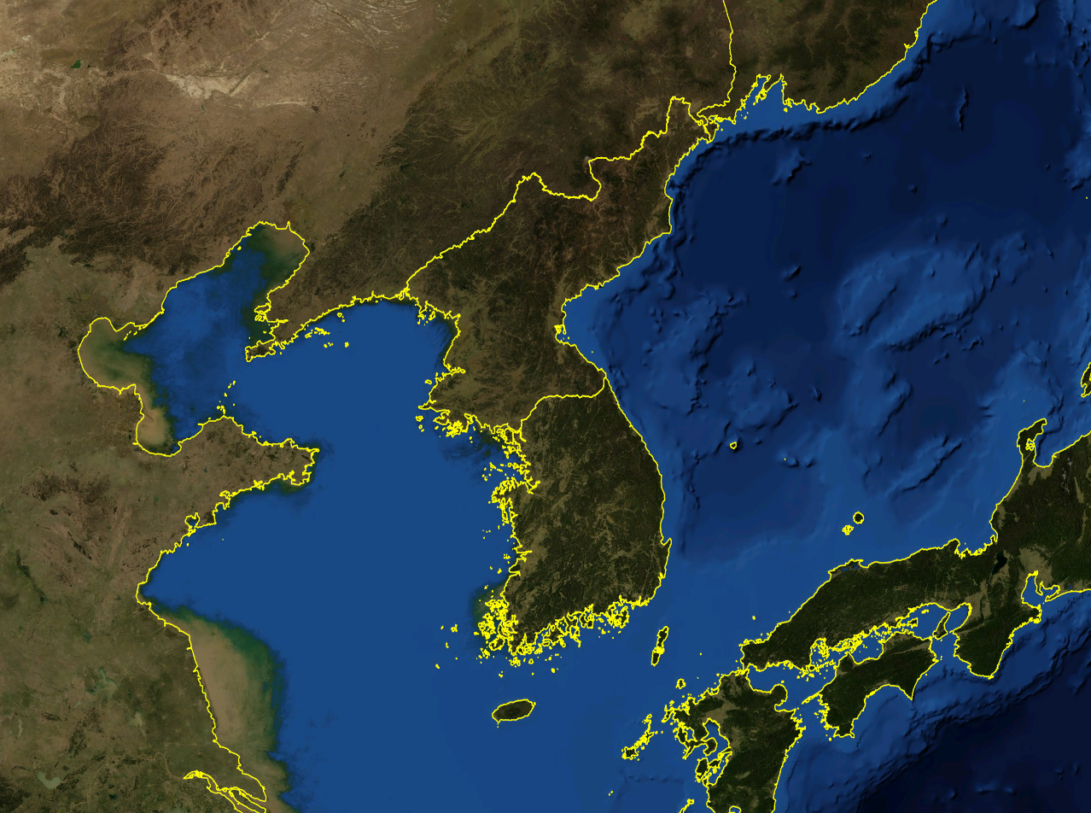
Peninsula – a body of land jutting into a lake or ocean surrounded by water on three sides.

Slide 57
Lake – body of water surrounded by land – usually freshwater.

Slide 58
Mouth of river – place where river empties into a larger body of water.

Slide 59
HYDROSPHERE: Earth’s Water
More than 70 percent of the Earth’s surface is covered by water.
About 97 percent of that is in the ocean;
most of the rest is frozen in the polar ice caps;
less than one percent is found in the atmosphere, groundwater or in freshwater lakes and rivers.

Slide 60
Oceans and Seas
The ocean is a connect body of salt water that covers 71% of the earth
Divided into 4 sections: Atlantic, Pacific, Indian and Arctic

Slide 61
Ocean Motion
Waves – Swells or ridges produced by winds

Slide 62
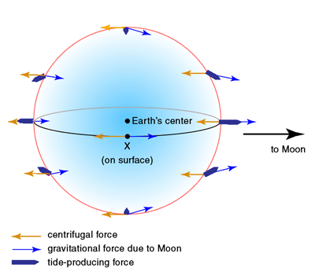
Ocean Motion
Tides – regular rises and falls of the ocean created by the gravitational pull of the moon or the sun

Slide 63
TIDES AND CURRENTS
The Earth’s ocean waters are in constant motion. This can be seen in the movement of their tides and current.

Slide 64
TIDES
Each day the surface level of the ocean rises and falls.
Tides are caused by the gravitational pull of the moon on Earth’s ocean waters.
Ocean waters directly facing the moon bulge toward the moon creating high tide, a time when sea levels are at their highest.
On the opposite side of the Earth is another high tide cause by the force of the Earth’s spin where the moon’s pull is weakest.
Sea levels are the highest when the moon and sun are on the same side of the Earth and lowest when they are on opposite sides.

Slide 65
TIDAL BULGES

Slide 66
CURRENTS
Ocean currents are the movements of the ocean’s waters.
Occur both at surface and below.
Surface currents are caused by spinning of Earth and winds.
At the Equator, the spinning of the Earth and winds push surface water towards the west. This sets in motion large circular surface currents.
Water heated by the sun moves away from the Equator , carrying heat energy towards the polar regions.
The transfer of energy helps maintain a balance – carrying warm water from the tropics to colder regions, and cold water from polar regions towards the tropics.

Slide 67
MAP OF OCEAN CURRENTS

Slide 68
The Gulf Stream carries warm water towards Great Britain which makes the country warmer than it would otherwise be.
Cold, salty water is more dense and sinks. It moves toward the equator, pushing warmer water away.

Slide 69
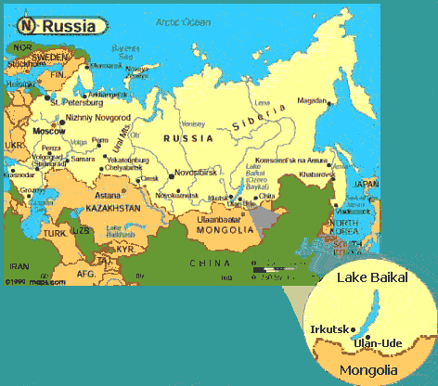
Lakes, Rivers and Streams
Lakes hold > 95% of earth’s fresh water
Result of glacial action
Salt water lakes result from surface changes that cut water off from the sea

Slide 70
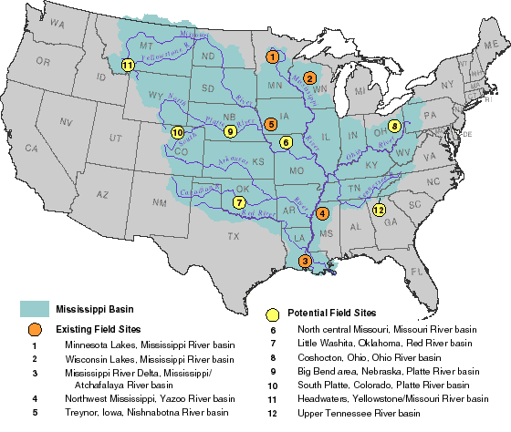
Lakes, Rivers and Streams
Rivers and streams flow through channels and move water to or from a larger body of water
An area drained by a major river and its tributaries is a drainage basin

Slide 71
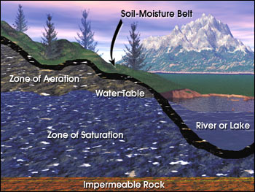
Ground Water
Water held in the pores of rocks
Water table – level at which the rock is saturated

Slide 72
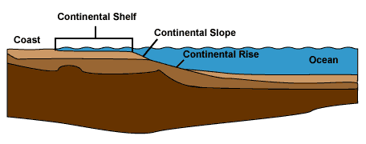
Oceanic Landforms
Continental shelf – the earth’s surface from the edge of a continent to the deep part of the ocean

Slide 73
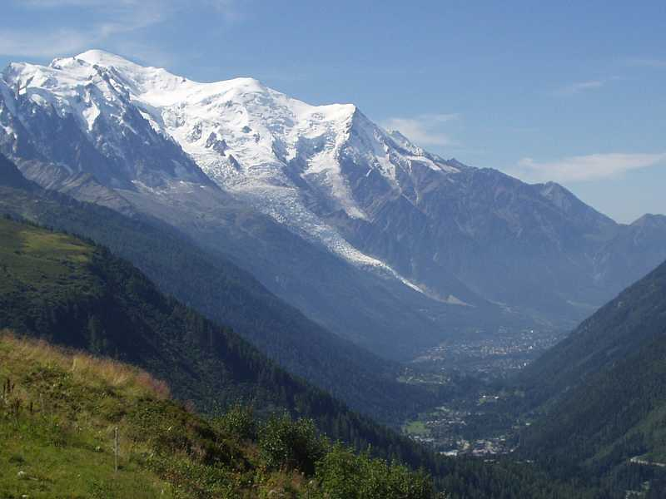
Continental Landforms
Relief – the difference in elevation of a landform from its lowest point to its highest point
4 categories: mountain, hills, plains, and plateaus

Slide 74
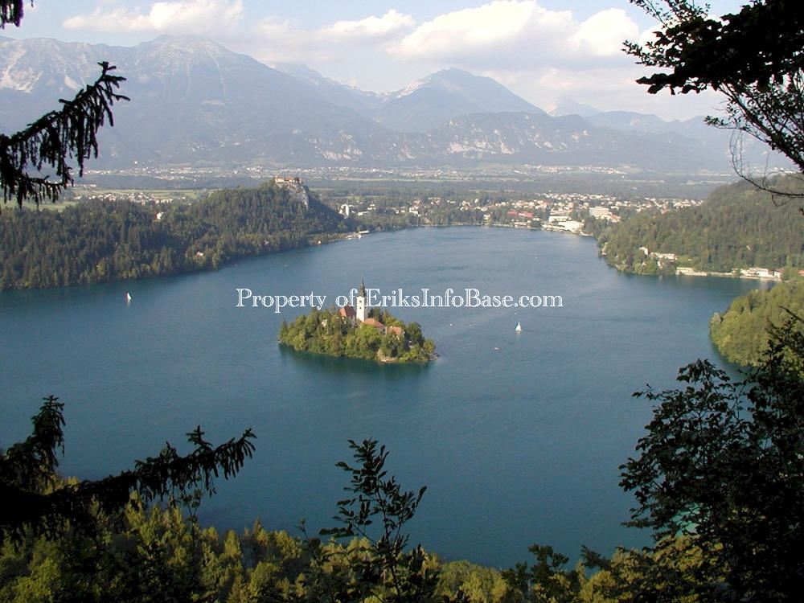
Major Hydrosphere Landforms
Island – a body of land surrounded by water

Slide 75
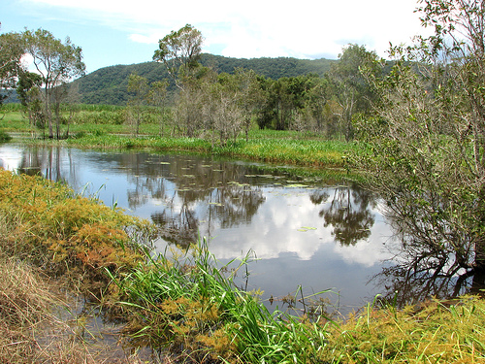
Swamp – a lowland region that is saturated by water

Slide 76
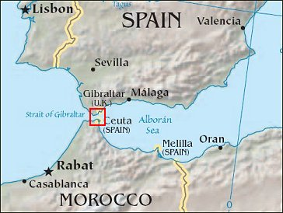
Strait – a narrow channel connecting 2 larger bodies of water

Slide 77
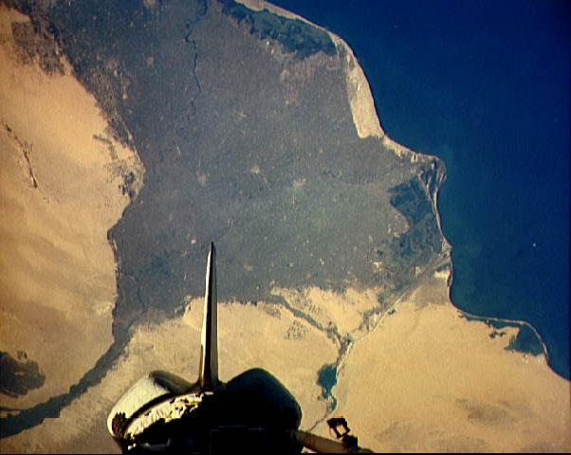
Delta – a triangular area of land formed from deposits at the mouth of a river

Slide 78
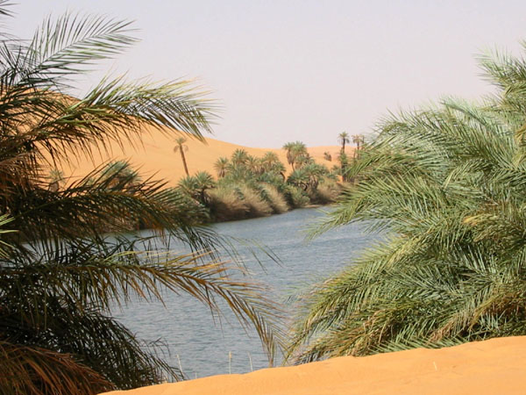
Oasis – a spot of fertile land in a desert, fed by water from wells or underground springs

Slide 79
Cataract – a step-like series of waterfalls

Slide 80
THE WATER CYCLE
The continuous circulation of water between the atmosphere, oceans and earth.
Water from the surface of the oceans and other bodies of water evaporates into the atmosphere.
The water then exists in the atmosphere as vapor.
When the vapor cools it condenses.
Then precipitation, either rain or snow, falls to the earth.
The rain or snow soaks into the ground, evaporates into the atmosphere, or flows into rivers to be recycled.

Slide 82
Label the Water Cycle

Slide 83
Atmosphere and Climate
Around the Earth is an envelope of gases known as the atmosphere. It consists of mainly nitrogen and oxygen.
The atmosphere absorbs solar radiation, moderates temperature and distributes water.
Weather refers to the conditions in the atmosphere closest to the earth, including humidity, winds and precipitation.
Climate is the average weather conditions of a place over a period of time.

Slide 84
Geography of Weather
Weather is affected by latitude, elevation, wind patterns, ocean currents and mountain barriers.
Temperatures are generally warmer when you get near the equator.
Temperatures are cooler at higher elevations.
Vertical climates are those different climates at different altitudes in the same area.

Slide 85
Winds
Winds are influenced by the Earth’s spin.
Winds may bring moist air and rain, such as the monsoons, or they may leave an area dry.

Slide 86
Mountains
Mountains may prevent moist air from reaching an area as air that rises over a mountain barrier cools.
The air loses its moisture and is drier when it reaches the other side of the mountain.
The ocean side of the mountain often has heavy rainfall.

Slide 87
Earth’s Seasons
Earth tilts on its axis as it revolves around the sun. Because of this tilt, the sun’s rays hit the Northern Hemisphere longer and more directly in summer than in winter. The sun appears to his higher in the sky, temperatures are warmer, and the days are longer.
When it is summer in the Northern Hemisphere it is winter in the Southern Hemisphere.
Seasonal differences are greatest at the poles and least at the equator. The area around the equator is not affected by the Earth’s tilt.

Slide 88
Distribution of Climate Regions
High-Latitude climates – The North and South Poles have similar “polar climates” with very cold winter temperatures. Include Subarctic, Tundra and Highland
Mid-Latitude climates – Places in middle latitudes with low elevation have warm summers and cool winters. These are called “temperate climates”.
Low-Latitude climates – Include both extreme “tropical moist climates” and “dry desert climates”.

Slide 89
The Biosphere: Climate and Biomes
The biosphere refers to all life on Earth. Weather patterns and climate influences what kinds of plants and animals can successfully live in a particular geographic location.
An ecosystem is an interdependent community of plants and animals. Based upon the interaction of climate, landforms, bodies of water, and soils scientists have identified several different biomes – distinct geographic regions with their own particular types of plant and animal life.

Slide 91
Temperate Deciduous Forest
Develop in mid-latitude regions where there is ample rain and moderate temps with cool winters.
Trees change color in fall and lose leaves in winter.

Slide 92
Coniferous Forest – those trees bearing cones and needles. Found in huge areas in northern regions of North America, Asia and Europe.

Slide 93
Tropical Rain Forests
Develop in tropical areas near the equator where there is ample rainfall and warm temperatures year-round.
Large trees cover the area with their leaves forming a canopy.
Tropical rainforests are marked by an abundance of animal and plant life.

Slide 94
Grassland
Exist where climate is drier and not enough rainfall to support large amounts of trees.
Grasses dominate these areas with large grazing animals like cattle, antelope or bison.
Savannas are grasslands with some trees.

Slide 95
Deserts
Regions that receive less than 10 inches rainfall annually.
Have own special forms of plant and animal life, which have adapted to extreme temperatures and lack of water.
Cacti and camels for example.

Slide 96
Deserts can be rocky or sandy.

Slide 97
Tundra
Found closer to polar regions.
Soil is so cold trees cannot grow.
Much of ground is frozen year-round
Tundra's have distinct biomes, with grasses, small shrubs, large mammals and birds that migrate to these regions in the warmer spring and summer months.

Slide 98
Tundra

